Slide 1
Data Mining (CSE 6506)
Classification
Mahmuda Naznin
Department of Computer Science Engineering, BUET

Slide 2
Supervised vs. Unsupervised Learning (1)
Supervised learning (classification)
Supervision: The training data such as observations or measurements are accompanied by labels indicating the classes which they belong to
New data is classified based on the models built from the training set
Training Data with class label:
Model
Learning
Outlook | Temp | Humidity | Windy | Play Golf
Rainy | Hot | High | False | No
Rainy | Hot | High | True | No
Overcast | Hot | High | False | Yes
Sunny | Mild | High | False | Yes
Sunny | Cool | Normal | False | Yes
Sunny | Cool | Normal | True | No
Overcast | Cool | Normal | True | Yes
Rainy | Mild | High | False | No
Training
Instances
Positive
Prediction
Model
Test
Instances
Negative

Slide 3
Supervised vs. Unsupervised Learning (2)
Unsupervised learning (clustering)
The class labels of training data are unknown
Given a set of observations or measurements, establish the possible existence of classes or clusters in the data

Slide 4
Prediction Problems: Classification vs. Numeric Prediction
Classification
Predict categorical class labels (discrete or nominal)
Construct a model based on the training set and the class labels (the values in a classifying attribute) and use it in classifying new data
Numeric prediction
Model continuous-valued functions (i.e., predict unknown or missing values)

Slide 5
Classification—Model Construction, Validation and Testing
Model Construction and Training
Model: Represented as decision trees, rules, mathematical formulas, or other forms
Assumption: Each sample belongs to a predefined class /class label
Training Set: The set of samples used for model construction

Slide 6
Classification—Model Construction, Validation and Testing
Model Validation and Testing:
Test: Estimate accuracy of the model
The known label of test sample VS. the classified result from the model
Accuracy: % of test set samples that are correctly classified by the model
Test set is independent of training set
Validation: If the test set is used to select or refine models, it is called validation (or development) (test) set
Model Deployment: If the accuracy is acceptable, use the model to classify new data
Notes:
Classification: Model Construction, Validation and Testing
Testing is used to estimate how accurate the model is.
In testing, we compare the true label of a test sample with the predicted label given by the model.
Accuracy means the percentage of test samples that are classified correctly.
The test set must be independent of the training set.
Validation is used when a dataset is used to select, tune, or refine the model during development.
So, validation helps improve the model before final testing.
Deployment means using the model on new unseen data after its accuracy is acceptable.
Main idea
Training builds the model
Validation helps tune the model
Testing checks final performance
Deployment uses the model in real applications

Slide 7
Step 1: Model Construction
Classification
Algorithms
Training
Data
Classifier
(Model)
IF rank = ‘professor’
OR years > 6
THEN tenured = ‘yes’

Slide 8
Step 2- Using the Model in Prediction
Classifier
Testing
Data
Unseen Data
(Jeff, Professor, 4)
Tenured?

Slide 9
Classification Techniques
Base Classifiers
Decision Tree based Methods
Rule-based Methods
Nearest-neighbor
Neural Networks
Deep Learning
Naïve Bayes and Bayesian Belief Networks
Support Vector Machines
Ensemble Classifiers
Boosting, Bagging, Random Forests

Slide 10
Decision Tree Induction
Training data set: Play Golf?
Outlook | Temp | Humidity | Windy | Play Golf
Rainy | Hot | High | False | No
Rainy | Hot | High | True | No
Overcast | Hot | High | False | Yes
Sunny | Mild | High | False | Yes
Sunny | Cool | Normal | False | Yes
Sunny | Cool | Normal | True | No
Overcast | Cool | Normal | True | Yes
Rainy | Mild | High | False | No
Rainy | Cool | Normal | False | Yes
Sunny | Mild | Normal | False | Yes
Rainy | Mild | Normal | True | Yes
Overcast | Mild | High | True | Yes
Overcast | Hot | Normal | False | Yes
Sunny | Mild | High | True | No
Decision tree construction:
A top-down, recursive, divide-and-conquer process
Resulting tree:
outlook?
Sunny
Rainy
Overcast
windy?
Yes
Humidity?
False
True
Normal
High
Yes
No
Yes
No
https://www.saedsayad.co/decision_tree.htm

Slide 11
Decision Tree Induction: Algorithm
Basic algorithm
Tree is constructed in a top-down, recursive, divide-and-conquer manner
At start, all the training examples are at the root
Examples are partitioned recursively based on selected attributes
On each node, attributes are selected based on the training examples on that node, and a heuristic or statistical measure (e.g., information gain, Gini index)
Notes:
Decision Tree Induction: Algorithm
A decision tree is built in a top-down, recursive, divide-and-conquer way.
At the beginning, all training examples are placed at the root node.
Then the data is split again and again based on selected attributes/features.
At each node, the best attribute is chosen using a measure such as Information Gain or Gini Index.
Main idea
The algorithm starts from the root, repeatedly splits the data using the best feature, and continues until the tree is formed.

Slide 12
Decision Tree Induction: Algorithm
Conditions for stopping partitioning
All samples for a given node belong to the same class
There are no remaining attributes for further partitioning
There are no samples left
Prediction
Majority voting is employed for classifying the leaf
Notes:
When does partitioning stop?
Decision tree splitting stops when:
all samples at a node belong to the same class
there are no more attributes left for further splitting
there are no samples left
Prediction
After the tree is built, the final class at a leaf node is usually decided by majority voting.
That means the class with the largest number of samples in that leaf is chosen.

Slide 13
Decision Tree Based Classification
Advantages:
Inexpensive to construct
Extremely fast at classifying unknown records
Easy to interpret for small-sized trees
Accuracy is comparable to other classification techniques for many simple data sets

Slide 14
Pro’s and Con’s in Details
Pro’s
Easy to explain (even for non-expert)
Easy to implement (many software)
Efficient
Can tolerant missing data
White box
No need to normalize data
Non-parametric: No assumption on data distribution, no assumption on attribute independency
Can work on various attribute types

Slide 15
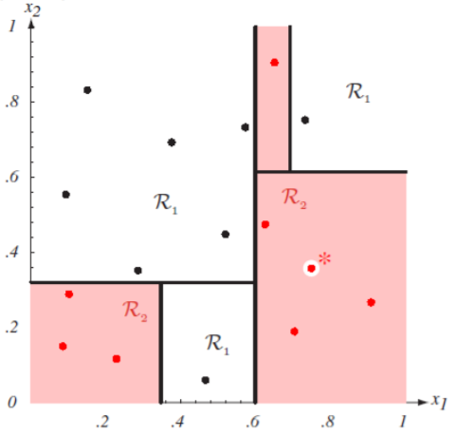
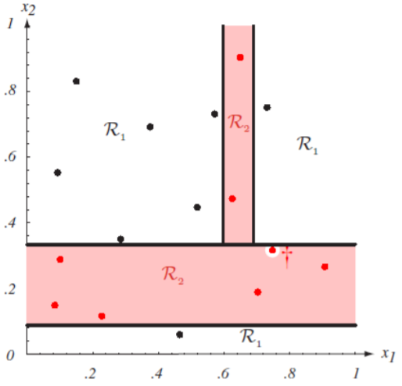
Con’s
Con’s
Unstable. Sensitive to noise
Accuracy may be not good enough (depending on your data)
The optimal splitting is NP. Greedy algorithms are used
Overfitting
Notes:
Cons of Decision Tree
Decision trees can be unstable, because a small change in data may create a different tree.
They are sensitive to noise and outliers.
Their accuracy may not always be very good, depending on the dataset.
Finding the optimal split is difficult, so practical methods use greedy algorithms instead of the perfect solution.
They are prone to overfitting, especially when the tree becomes too deep.

Slide 16
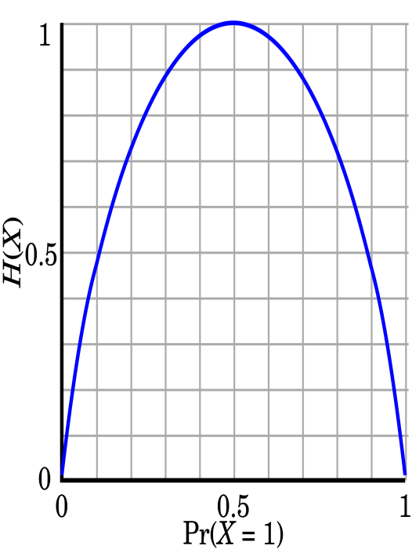
Splitting Measures: Information Gain
Entropy (Information Theory)
A measure of uncertainty associated with a random number
Calculation: For a discrete random variable Y taking m distinct values {y₁, y₂, …, y_{m}}
Interpretation
Higher entropy → higher uncertainty
Lower entropy → lower uncertainty
Conditional entropy
m = 2
Notes:
Entropy
Entropy is a measure of uncertainty or impurity in the class labels.
If entropy is high, the data is more mixed and uncertain.
If entropy is low, the data is purer and more certain.
Formula
$$H\left(Y\right)=−\sum{p_{i}}log⁡\left(p_{i}\right)$$
where $p_{i}$is the probability of class $i$.
Conditional Entropy
Conditional entropy means the remaining uncertainty in Y after knowing X.
It is written as:
$$H\left(Y∣X\right)=\sum{p}\left(x\right) H\left(Y∣X=x\right)$$
Why it is used in decision tree
A good split should reduce entropy.
The attribute that reduces uncertainty the most is preferred.

Slide 17
Example: Attribute Selection with Information Gain
Gain(Temp)=.029
Gain (Humidity)=.151
Gain (Windy)=.048
Outlook | Temp | Humidity | Windy | Play Golf
Rainy | Hot | High | False | No
Rainy | Hot | High | True | No
Overcast | Hot | High | False | Yes
Sunny | Mild | High | False | Yes
Sunny | Cool | Normal | False | Yes
Sunny | Cool | Normal | True | No
Overcast | Cool | Normal | True | Yes
Rainy | Mild | High | False | No
Rainy | Cool | Normal | False | Yes
Sunny | Mild | Normal | False | Yes
Rainy | Mild | Normal | True | Yes
Overcast | Mild | High | True | Yes
Overcast | Hot | Normal | False | Yes
Sunny | Mild | High | True | No
Temp | Yes | No | I(Yes, No)
Hot | 2 | 2 | ?
Mild | 4 | 2 | ?
Cool | 3 | 1 | ?
Windy | Yes | No | I(Yes, No)
True | ? | ? | ?
False | ? | ? | ?
Humidity | Yes | No | I(Yes, No)
Normal | 6 | 1 | ?
High | 3 | 4 | ?

Slide 18
Design Issues of Decision Tree Induction
How should training records be split?
Method for specifying test condition
depending on attribute types
Measure for evaluating the goodness of a test condition
How should the splitting procedure stop?
Stop splitting if all the records belong to the same class or have identical attribute values
Early termination
Notes:
Training records are split based on attribute type and evaluated using measures like information gain or Gini index. Splitting stops when all records belong to the same class, attributes are identical, or early termination conditions are met.

Slide 19
Methods for Expressing Test Conditions
Depends on attribute types
Binary
Nominal
Ordinal
Continuous
Depends on number of ways to split
2-way split
Multi-way split

Slide 20
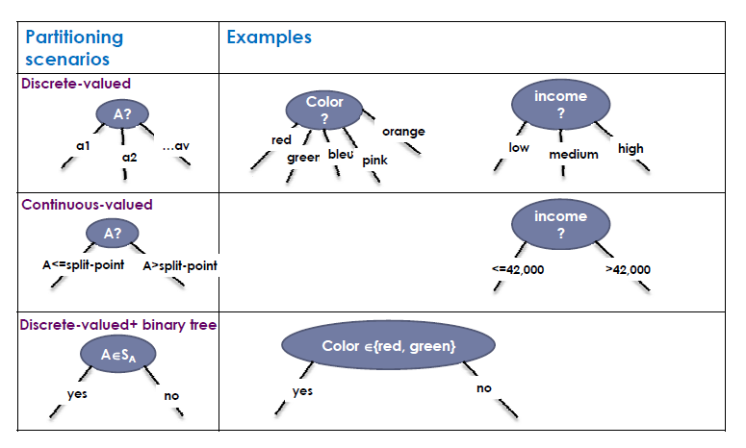
Three Possible Partition Scenarios

Slide 21
How to Handle Continuous-Valued Attributes?
Different ways of handling
Discretization to form an ordinal categorical attribute
Ranges can be found by equal interval bucketing, equal frequency bucketing (percentiles), or clustering.
Static – discretize once at the beginning
Dynamic – repeat at each node
Binary Decision: (A < v) or (A ≥ v)
consider all possible splits and finds the best cut
can be more compute intensive
Notes:
1. Discretization
Convert the continuous attribute into ranges or categories.
These ranges can be made by:
equal interval bucketing
equal frequency bucketing
clustering
Static discretization: done once at the beginning
Dynamic discretization: repeated at each node during tree building
2. Binary decision
Split the attribute using a threshold value, such as: $A<v$or $A≥v$
The algorithm checks possible split points and selects the best cut.
This method can be more computationally expensive.
Main idea
Continuous attributes can be handled either by converting them into categories or by finding the best threshold to split them into two parts.

Slide 22
How to Handle Continuous-Valued Attributes?
Method 1: Discretize continuous values and treat them as categorical values
E.g., age: < 20, 20..30, 30..40, 40..50, > 50
Method 2: Determine the best split point for continuous-valued attribute A
Sort:, e.g. 15, 18, 21, 22, 24, 25, 29, 31, …
Possible split point: (a_{i}+a_{i+1})/2
e.g., (15+18)/2 = 16.5, 19.5, 21.5, 23, 24.5, 27, 30, …
The point with the maximum information gain for A is selected as the split-point for A
Split: Based on split point P
The set of tuples in D satisfying A ≤ P vs. those with A > P
Notes:
Handling Continuous-Valued Attributes
There are two methods:
Method 1: Discretization
Convert continuous values into categorical ranges.
Example for age: < 20, 20–30, 30–40, 40–50, > 50
Method 2: Find the best split point
First, sort the values of the continuous attribute.
Then compute possible split points using the midpoint of two consecutive values:
$$\text{Split} \text{point}=\frac{a_{i}+a_{i+1}}{2}$$
Example: if values are 15, 18, 21, 22, then possible split points are: 16.5, 19.5, 21.5
Among all possible split points, choose the one with the highest information gain.
Then split the data into:
$$A≤P$$
$$A>P$$
Main idea
A continuous attribute can be handled either by converting it into ranges or by choosing the best threshold that gives the best split.

Slide 23
Test Condition for Nominal Attributes
Multi-way split:
Use as many partitions as distinct values.
Binary split:
Divides values into two subsets

Slide 24
Test Condition for Ordinal Attributes
Multi-way split:
Use as many partitions as distinct values
Binary split:
Divides values into two subsets
Preserve order property among attribute values
This grouping violates order property

Slide 25
Test Condition for Continuous Attributes

Slide 26
Decision Tree Induction: Example-2
Training data set:
Buys_computer
Resulting tree:
age?
<=30
overcast
>40
31..40
student?
yes
credit rating?
no
yes
excellent
fair
no
yes
no
yes

Slide 27
Attribute Selection Measures
An attribute selection measure is a heuristic for selecting the splitting criterion that “best” separates a given data partition D
Ideally
Each resulting partition would be pure
A pure partition is a partition containing tuples that all belong to the same class
Attribute selection measures (splitting rules)
Determine how the tuples at a given node are to be split
Provide ranking for each attribute describing the tuples
Methods
Information gain
Gain ratio
Gini Index
Notes:
Attribute Selection Measures
An attribute selection measure is a rule used to choose the best attribute for splitting at a decision tree node.
The goal is to split the data so that the resulting groups become as pure as possible.
A pure partition means most or all tuples in that group belong to the same class.
Why it is needed
It decides how the data at a node should be split.
It also gives a ranking of attributes, so the best one can be selected.
Common methods
Information Gain
Gain Ratio
Gini Index

Slide 28
Attribute Selection: Information Gain
Select the attribute with the highest information gain
Let p_{i} be the probability that an arbitrary tuple in D belongs to class C_{i}, estimated by |C_{i, D}|/|D|
Expected information (entropy) needed to classify a tuple in D:
Information needed (after using A to split D into v partitions) to classify D:
Information gained by branching on attribute A
Notes:
28

Slide 29
Attribute Selection: Information Gain
Class P: buys_computer = “yes”
Class N: buys_computer = “no”
means “age <=30” has 5 out of 14 samples, with 2 yes’s and 3 no’s. Hence
Similarly,

Slide 30
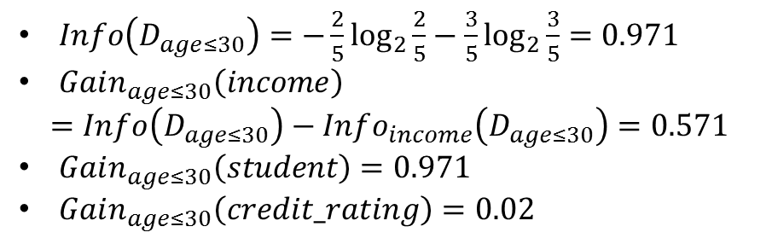

Attribute Selection : Information Gain
age?
$Info\left(D_{age≤30}\right)=−\frac{2}{5}\log_{2}{\frac{2}{5}}−\frac{3}{5}\log_{2}{\frac{3}{5}}=0.971$
$Gain_{age≤30}\left(income\right)$
$$=Info\left(D_{age≤30}\right)−Info_{income}\left(D_{age≤30}\right)=0.571$$
$Gain_{age≤30}\left(student\right)=0.971$
$Gain_{age≤30}\left(credit_rating\right)=0.02$
<=30
overcast
>40
31..40
?
yes
?
age?
Which attribute next?
<=30
overcast
>40
31..40
student?
yes
?
$$D_{age≤30}$$
no
yes
no
yes

Slide 31
Computing Information-Gain for
Continuous-Valued Attributes
Let attribute A be a continuous-valued attribute
Must determine the best split point for A
Sort the value A in increasing order
Typically, the midpoint between each pair of adjacent values is considered as a possible split point
(a_{i}+a_{i+1})/2 is the midpoint between the values of a_{i} and a_{i+1}
The point with the minimum expected information requirement for A is selected as the split-point for A
Split:
D1 is the set of tuples in D satisfying A ≤ split-point, and D2 is the set of tuples in D satisfying A > split-point
Notes:
Information Gain for Continuous-Valued Attributes
If an attribute A is continuous (like age, salary, temperature), we cannot split it by fixed categories directly. So we must find the best split point.
How it works
Sort all values of attribute A in increasing order.
Take the midpoint between every two adjacent values as a possible split point. If two values are $a_{i}$and $a_{i+1}$, then candidate split point is:
$$\frac{a_{i}+a_{i+1}}{2}$$
For each candidate split point, divide the data into two groups:
D1: tuples with $A≤$split point
D2: tuples with $A>$split point
Compute the expected information (entropy after split) for each candidate.
Choose the split point with the minimum expected information (equivalently, the maximum information gain).
Main meaning
We test many possible cut points and choose the one that separates the classes best.

Slide 32
Attribute Selection Measure: Gain Ratio
Information gain measure is biased towards attributes with a large number of values
E.g: attribute acting as unique identifier
Produce a large number of partitions (1 tuple per partition)
Each resulting partition D is pure Info(D)=0
The information gain is maximized
Extension to Information Gain
known as gain ratio
Overcomes the bias of Information gain
Applies a kind of normalization to information gain using a split information value
Notes:
Gain Ratio — simple
Information Gain is biased toward attributes that have many different values.
Example: a unique ID attribute
It can split data into many tiny groups
Often one record per group
Then each group becomes pure $\left(Info=0\right)$
So Information Gain becomes very high
But this split is not really useful for prediction
Why Gain Ratio is used
Gain Ratio is an extension of Information Gain
It reduces this bias
It does this by normalizing Information Gain using split information
Main idea
Information Gain = how much uncertainty is reduced
Gain Ratio = information gain adjusted so attributes with too many values are not unfairly favored

Slide 33
Attribute Selection Measure: Gain Ratio
The split information value represents the potential information generated by splitting the training data set D into v partitions, corresponding to v outcomes on attribute A
GainRatio(A) = Gain(A)/SplitInfo(A)
High splitInfo: partitions have more or less the same size (uniform)
Low split Info: few partitions hold most of the tuples (peaks)
Ex.
gain_ratio(income) = 0.029/1.557 = 0.019
The attribute with the maximum gain ratio is selected as the splitting attribute
Notes:
Gain Ratio — formula meaning (simple)
1. SplitInfo
SplitInfo measures how broadly attribute A splits the data into groups.
$$SplitInfo_{A}\left(D\right)=−\sum_{j=1}^{v}{\frac{∣D_{j}∣}{∣D∣}}{\log{}}_{2}\left(\frac{∣D_{j}∣}{∣D∣}\right)$$
If the split makes many balanced groups, SplitInfo is high
If most records stay in one or two groups, SplitInfo is low
2. Gain Ratio
$$GainRatio\left(A\right)=\frac{Gain\left(A\right)}{SplitInfo\left(A\right)}$$
So Gain Ratio = Information Gain / SplitInfo
It reduces the unfair advantage of attributes with too many values.
3. Example from the slide
For income:
$$SplitInfo_{income}\left(D\right)=−\frac{4}{14}{\log{}}_{2}\frac{4}{14}−\frac{6}{14}{\log{}}_{2}\frac{6}{14}−\frac{4}{14}{\log{}}_{2}\frac{4}{14}=1.557$$
Given:
$$Gain\left(income\right)=0.029$$
So,
$$GainRatio\left(income\right)=\frac{0.029}{1.557}=0.019$$

Slide 34
Attribute Selection Measure: Gini Index
If a data set D contains examples from n classes, gini index, gini(D) is defined as
where p_{j} is the relative frequency of class j in D
If a data set D is split on A into two subsets D₁ and D₂, the gini index gini(D) is defined as
Reduction in Impurity:
The attribute provides the smallest gini_{split}(D) (or the largest reduction in impurity) is chosen to split the node (need to enumerate all the possible splitting points for each attribute)

Slide 35
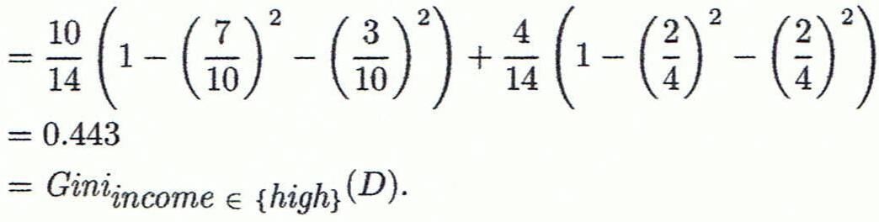
Attribute Selection Measure: Gini Index
Example- D has 9 tuples in buys_computer = “yes” and 5 in “no”
The attribute income partitions D into 10 in D₁: {low, medium} and 4 in D₂
Gini_{{low,high}} is 0.458; Gini_{{medium,high}} is 0.450. Thus, split on the {low,medium} (and {high}) since it has the lowest Gini index
Notes:
Gini Index — simple meaning
Gini Index measures how impure a dataset is.
Lower Gini means better split (more pure groups).
Step 1: Gini of whole dataset
There are:
9 yes
5 no
$$Gini\left(D\right)=1−{\left(\frac{9}{14}\right)}^{2}−{\left(\frac{5}{14}\right)}^{2}=0.459$$
Step 2: Try a split on income
Split into:
D1 = {low, medium} → 10 tuples
D2 = {high} → 4 tuples
Now compute weighted Gini:
$$Gini_{income}\left(D\right)=\frac{10}{14}Gini\left(D_{1}\right)+\frac{4}{14}Gini\left(D_{2}\right)$$
For $D_{1}$: 7 yes, 3 no
$$Gini\left(D_{1}\right)=1−{\left(\frac{7}{10}\right)}^{2}−{\left(\frac{3}{10}\right)}^{2}$$
For $D_{2}$: 2 yes, 2 no
$$Gini\left(D_{2}\right)=1−{\left(\frac{2}{4}\right)}^{2}−{\left(\frac{2}{4}\right)}^{2}$$
So,
$$Gini_{income}\left(D\right)=\frac{10}{14}\left(0.42\right)+\frac{4}{14}\left(0.5\right)=0.443$$
Compare splits
$$Gini_{\left\{l , owhigh\right\}}=0.458$$
$$Gini_{\left\{m , ediumhigh\right\}}=0.450$$
$$Gini_{\left\{l , owmedium\right\}}=0.443$$
Final decision
Choose the split:
$$\left\{l , owmedium\right\} \text{and} \left\{high\right\}$$
because it has the lowest Gini index.

Slide 36
Information Gain vs. Gini Index
http://www.learnbymarketing.com/481/decision-tree-flavors-gini-info-gain/
Favors splits with small counts but many unique values.
A smaller value of Entropy is better. That makes the difference between the parent node’s entropy larger.
The maximum value for Entropy depends on the number of classes.
Notes:
Measure used
Information Gain: based on entropy
Gini Index: based on Gini impurity
Goal
Information Gain: choose split with maximum gain
Gini Index: choose split with minimum Gini
Bias
Information Gain: tends to favor attributes with many unique values
Gini Index: usually less biased toward many-valued attributes
Computation
Information Gain: uses logarithm, so a bit more complex
Gini Index: simpler, no log is needed

Slide 37
Gini Index
Favors larger partitions.
Uses squared proportion of classes.
If perfectly classified, Gini Index would be zero.
Evenly distributed would be 1 – (1/# Classes).
We want a variable split that has a low Gini Index.
Notes:
Favors larger partitions
Uses the squared proportions of class probabilities
If the node is perfectly pure, Gini = 0
If classes are evenly distributed, Gini is high
$$1−\frac{1}{\text{number} \text{of} \text{classes}}$$
In decision trees, we prefer the split with the lowest Gini Index

Slide 38
Splitting Criteria based on Misclassification Error
Classification error at a node t :
Measures misclassification error made by a node.
Maximum (1 - 1/n_{c}) when records are equally distributed among all classes, implying least interesting information
Minimum (0.0) when all records belong to one class, implying most interesting information
Notes:
Misclassification Error — simple
At a node $t$,
$$Error\left(t\right)=1−\underset{i}{\max{}}P\left(i∣t\right)$$
Meaning
Find the class with the highest probability in that node
Subtract it from 1
That gives the misclassification error
Intuition
If one class dominates the node, error is low
If classes are evenly mixed, error is high
Special cases
Minimum error = 0
when all records belong to one class
Maximum error = $1−\frac{1}{n_{c}}$
when records are equally distributed among all classes
Here, $n_{c}$= number of classes.

Slide 39
Examples for Misclassification Error
P(C1) = 0/6 = 0 P(C2) = 6/6 = 1
Error = 1 – max (0, 1) = 1 – 1 = 0
P(C1) = 1/6 P(C2) = 5/6
Error = 1 – max (1/6, 5/6) = 1 – 5/6 = 1/6
P(C1) = 2/6 P(C2) = 4/6
Error = 1 – max (2/6, 4/6) = 1 – 4/6 = 1/3

Slide 40
Classification Error vs. Gini Index
A?
Yes
No
Node N1
Node N2
Gini(Children) = 3/10 * 0 + 7/10 * 0.489 = 0.342
Gini(N1) = 1 – (3/3)² – (0/3)² = 0
Gini(N2) = 1 – (4/7)² – (3/7)² = 0.489
Notes:
Classification Error vs. Gini Index — simple idea
Parent node has:
C1 = 7
C2 = 3
So parent Gini is:
$$Gini\left(parent\right)=1−{\left(\frac{7}{10}\right)}^{2}−{\left(\frac{3}{10}\right)}^{2}=0.42$$
After split
Node N1
C1 = 3
C2 = 0
$$Gini\left(N1\right)=1−{\left(\frac{3}{3}\right)}^{2}−{\left(\frac{0}{3}\right)}^{2}=0$$
This node is pure.
Node N2
C1 = 4
C2 = 3
$$Gini\left(N2\right)=1−{\left(\frac{4}{7}\right)}^{2}−{\left(\frac{3}{7}\right)}^{2}=0.489$$
This node is still mixed.
Weighted Gini of children
$$Gini\left(children\right)=\frac{3}{10}\left(0\right)+\frac{7}{10}\left(0.489\right)$$
$$=0+0.3423$$
$$≈0.342$$
Meaning
Parent Gini = 0.42
Children Gini = 0.342
Since Gini decreased, the split is better than before.
Main point
A good split makes child nodes more pure, so weighted Gini becomes smaller.

Slide 41
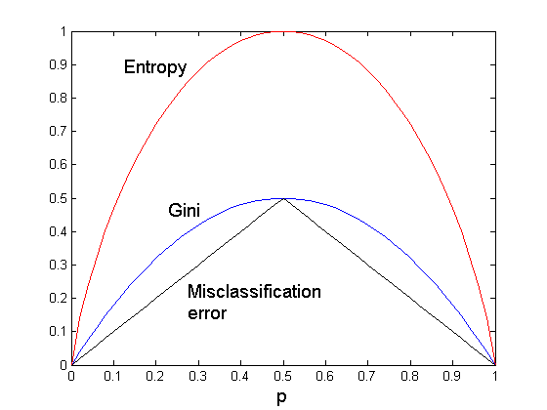
Comparison - Three Splitting Criteria
For a 2-class problem:
Notes:
For a 2-class problem, the graph compares how Entropy, Gini Index, and Misclassification Error change with class probability $p$. All three become 0 when a node is completely pure ($p=0$ or $p=1$), and all are maximum at $p=0.5$when the two classes are equally mixed. Entropy rises the fastest and is most sensitive to class mixing, Gini is moderately sensitive, and Misclassification Error is the least sensitive because its curve is flatter. So, in practice, Entropy and Gini are usually better for selecting splits, while Misclassification Error is often used more for pruning or evaluation.

Slide 42
Tree Induction
Greedy strategy.
Split the records based on an attribute test that optimizes certain criterion.
Issues
Determine how to split the records
How to specify the attribute test condition?
How to determine the best split?
Determine when to stop splitting

Slide 43
Stopping Criteria for Tree Induction
Stop expanding a node when all the records belong to the same class
Stop expanding a node when all the records have similar attribute values
Early termination

Slide 44
Practical Issues of Classification
Underfitting and Overfitting
Missing Values
Costs of Classification
Notes:
Practical Issues of Classification
Underfitting and Overfitting
Underfitting: model is too simple, so it cannot learn the pattern well
Overfitting: model learns training data too closely, so it performs badly on new data
Missing Values
Some attribute values may be unknown or absent
This makes training and prediction harder
Costs of Classification
Different classification errors may have different costs
Example: predicting a sick patient as healthy may be more serious than the opposite error

Slide 45
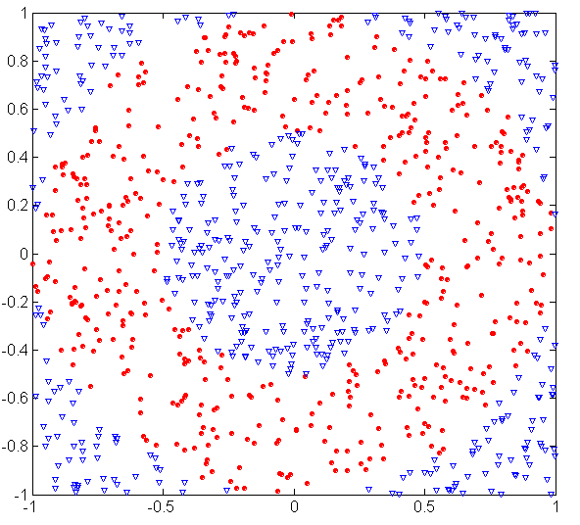
Underfitting and Overfitting (Example)
500 circular and 500 triangular data points.
Circular points:
0.5 ≤ sqrt(x₁²+x₂²) ≤ 1
Triangular points:
sqrt(x₁²+x₂²) > 0.5 or
sqrt(x₁²+x₂²) < 1

Slide 46
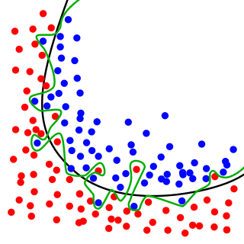
Overfitting Example
A model that has learned the noise instead of the signal is considered “overfit” because it fits the training dataset but has poor fit with new datasets.
Underfitting occurs when a model is too simple – informed by too few features or regularized too much – which makes it inflexible in learning from the dataset. (Black line-Good fit, Green Line-Overfit)
Notes:
Overfitting Example
Overfitting happens when a model learns the noise of the training data instead of the true pattern
It gives good training accuracy but performs poorly on new data
In the figure
Black line = good fit
captures the main trend
Green line = overfit
bends too much to follow individual points/noise
Underfitting
Happens when the model is too simple
It cannot learn the real pattern well from the data

Slide 47
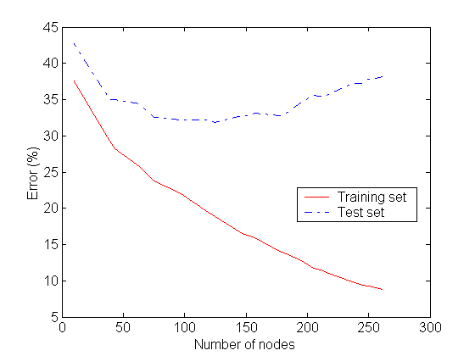
Underfitting and Overfitting
Overfitting
Underfitting: when model is too simple, both training and test errors are large

Slide 48
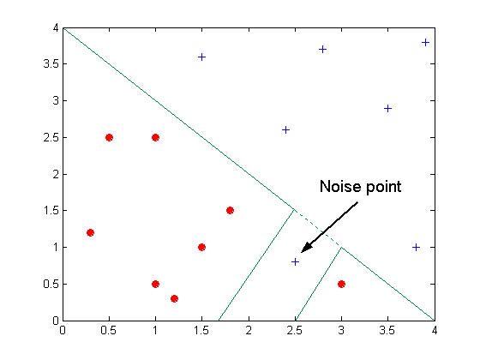
Overfitting due to Noise
Decision boundary is distorted by noise point

Slide 49
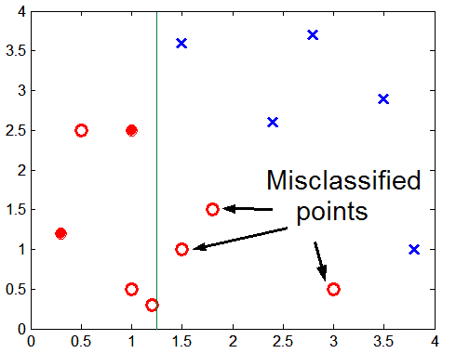
Overfitting due to Insufficient Examples
Lack of data points in the lower half of the diagram makes it difficult to predict correctly the class labels of that region
Insufficient number of training records in the region causes the decision tree to predict the test examples using other training records that are irrelevant to the classification task
(green is the boundary, two red data for training in the class)
Notes:
Overfitting due to Insufficient Examples
If some region has very few training points, the model cannot learn the true pattern there
Then the decision tree may create a rule using irrelevant nearby training examples
As a result, some test points are misclassified
In the figure
Green line = decision boundary
Because the lower-right/lower region has insufficient examples, the boundary is not reliable there
So some points are predicted wrongly

Slide 50
Overfitting and Tree Pruning
Overfitting: An induced tree may overfit the training data
Too many branches, some may reflect anomalies due to noise or outliers
Poor accuracy for unseen samples during testing
Two approaches to avoid overfitting
Prepruning: Halt tree construction early ̵ do not split a node if this would result in the goodness measure falling below a threshold
Problem-Difficult to choose an appropriate threshold
Postpruning: Remove branches from a “fully grown” tree—get a sequence of progressively pruned trees
Problem-Use a set of data different from the training data to decide which is the “best pruned tree”
Notes:
Overfitting occurs when a decision tree becomes too complex (too many branches) and fits noise in training data, resulting in poor performance on unseen data.
Method to avoid overfitting:
1. Prepruning:
Stop splitting early if the split is not good enough (below threshold). ✔ Advantage: Faster ✖ Problem: Hard to choose correct threshold
2. Postpruning
First build full tree, then remove unnecessary branches. ✔ Advantage: More accurate ✖ Problem: Needs separate validation data

Slide 51
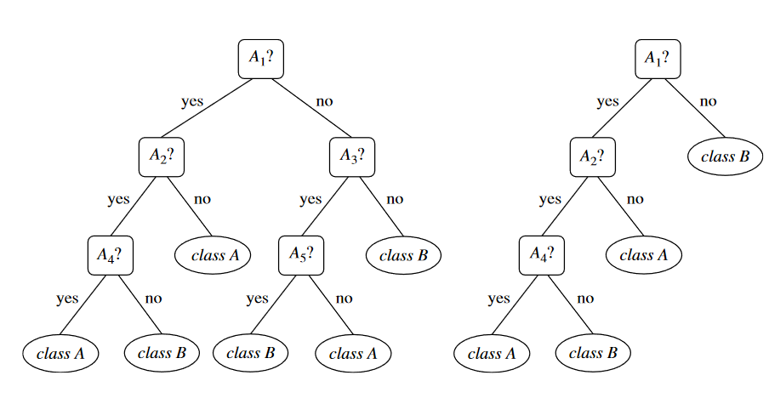
Pruning with Majority Class

Slide 52
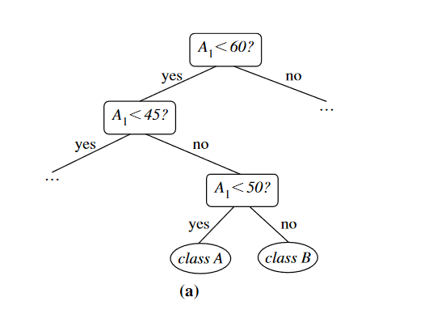
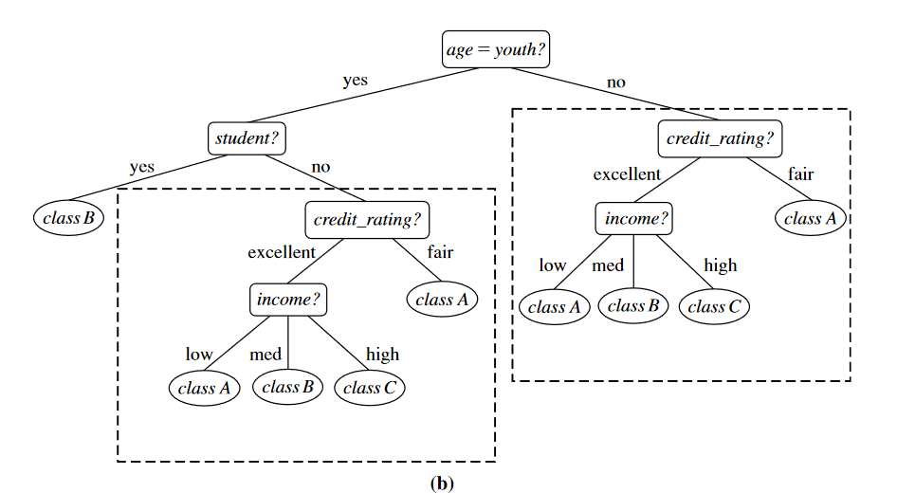
Pruning by Eliminating Repetition

Slide 53
Enhancements to Basic Decision Tree Induction (Summary)
Allow for continuous-valued attributes
Dynamically define new discrete-valued attributes that partition the continuous attribute value into a discrete set of intervals
Handle missing attribute values
Assign the most common value of the attribute
Assign probability to each of the possible values
Attribute construction
Create new attributes based on existing ones that are sparsely represented
This reduces fragmentation, repetition, and replication
Notes:
1. Continuous-valued attributes
Some data are numbers (like age, salary).
Decision trees convert these into ranges (like age < 30, age ≥ 30).
So, continuous data becomes easier to use.
2. Missing attribute values
Sometimes data is missing.
Two ways to handle it:
Use the most common value
Or assign probabilities to possible values
3. Attribute construction
Create new attributes from existing ones.
Useful when data is limited or scattered.
Helps reduce:
Fragmentation (data split too much)
Repetition
Redundant data
Convert continuous data → ranges Handle missing values → common value / probability Create new useful attributes → better and simpler tree

Slide 54
Enhancements to Basic Decision Tree Induction (Summary)
Incremental induction
It is not good to generate the tree from scratch at every time that new instances arriving
Dynamically adjust the splits in the tree
Scalable decision tree algorithms
Most studies focus on improving the data structures
Notes:
1. Incremental induction
Do not rebuild the whole tree every time new data comes.
Instead, update the existing tree step by step.
Adjust the splits when new data arrives.
2. Scalable decision tree algorithms
For large data, algorithms must be efficient.
Focus is on improving data structures to handle big datasets faster.

Slide 55
Acknowledgement
Jiawei Han (UIUC) (CS412)
Vipin Kumar et al., University of Minnesota at Twin Cities

